Slide 1
Accident and their prevention Accident Causation Theories
UNIT -III

Slide 2
Accident - Definition
Accidents are defined as unplanned occurrences which result in injuries, fatalities, loss of production or damage to property and assets.
Preventing accidents is extremely difficult in the absence of an understanding of the causes of accidents.
Many attempts have been made to develop a prediction theory of accident causation, but so far none has been universally accepted.
Researchers from different fields of science and engineering have been trying to develop a theory of accident causation which will help to identify, isolate and ultimately remove the factors that contribute to or cause accidents.
In this presentation, a brief outline of various accident causation theories is presented, followed by a structure of accidents.

Slide 3
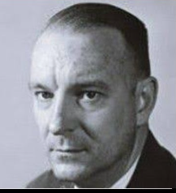
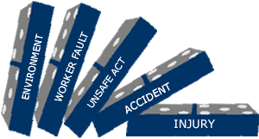
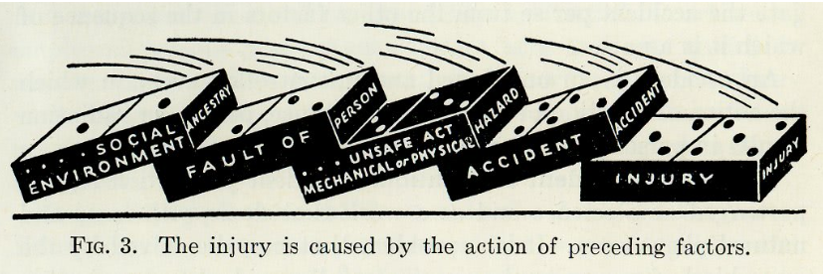
The Domino theory
W.H. Heinrich
According to W.H. Heinrich (1931), who developed the so-called domino theory, 88% of all accidents are caused by unsafe acts of people, 10% by unsafe actions and 2% by “acts of God”. He proposed a “five-factor accident sequence” in which each factor would actuate the next step in the manner of toppling dominoes lined up in a row. The sequence of accident factors is as follows:
ancestry and social environment
worker fault
unsafe act together with mechanical and physical hazard
accident
damage or injury.

Slide 4
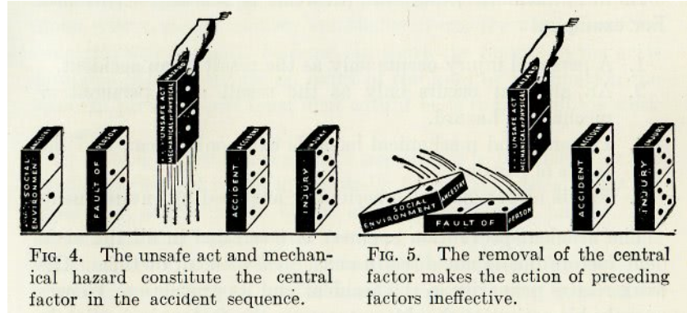
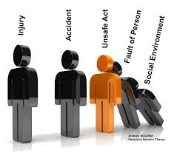
In the same way that the removal of a single domino in the row would interrupt the sequence of toppling
Heinrich suggested that removal of one of the factors would prevent the accident and resultant injury; with the key domino to be removed from the sequence being number 3.
Although Heinrich provided no data for his theory, it nonetheless represents a useful point to start discussion and a foundation for future research.

Slide 5
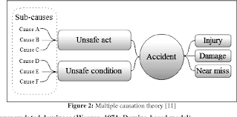
Multiple causation theory
Multiple causation theory is an outgrowth of the domino theory, but it postulates that for a single accident there may be many contributory factors, causes and sub-causes, and that certain combinations of these give rise to accidents.

Slide 6
According to this theory, the contributory factors can be grouped into the following two categories:
1. Behavioural. This category includes factors pertaining to the worker, such as
improper attitude
lack of knowledge
lack of skills
inadequate physical and mental condition.
2. Environmental. This category includes:
Improper guarding of other hazardous work elements
Degradation of equipment through use and unsafe procedures.
Major contribution of this theory - To bring out the fact that rarely, if ever, is an accident the result of a single cause or act.

Slide 7
The pure chance theory
According to the pure chance theory, every one of any given set of workers has an equal chance of being involved in an accident.
It further implies that there is no single visible pattern of events that leads to an accident.
In this theory, all accidents are treated as corresponding to Heinrich’s acts of God, and it is held that there exist no interventions to prevent them.

Slide 8
Biased liability theory
Biased liability theory is based on the view that
once a worker is involved in an accident, the chances of the same worker becoming involved in future accidents are either increased or decreased as compared to the rest of workers.
This theory contributes very little, if anything at all, towards developing preventive actions for avoiding accidents.

Slide 9
Accident proneness theory
Accident proneness theory maintains that within a given set of workers, there exists a subset of workers who are more liable to be involved in accidents.
Drawback
Researchers have not been able to prove this theory conclusively because most of the research work has been poorly conducted and most of the findings are contradictory and inconclusive.
This theory is not generally accepted.
It is felt that if indeed this theory is supported by any empirical evidence at all, it probably accounts for only a very low proportion of accidents without any statistical significance.

Slide 10
The energy transfer theory
Claim: Worker incurs injury or equipment suffers damage through a change of energy, and that for every change of energy there is a source, a path and a receiver.
This theory is useful for determining injury causation and evaluating energy hazards and control methodology. Strategies can be developed which are either preventive, limiting or ameliorating with respect to the energy transfer.

Slide 11
Control of energy transfer at the source can be achieved by the following means:
elimination of the source
changes made to the design or specification of elements of the work station
preventive maintenance.
The path of energy transfer can be modified by:
enclosure of the path
installation of barriers
installation of absorbers
positioning of isolators.
The receiver of energy transfer can be assisted by adopting the following measures:
limitation of exposure
use of personal protective equipment.

Slide 12
The “symptoms versus causes” theory
The “symptoms versus causes” theory is not so much a theory as an admonition to be heeded if accident causation is to be understood.
Usually, when investigating accidents, we tend to fasten upon the obvious causes of the accident to the neglect of the root causes.
Unsafe acts and unsafe conditions are the symptoms—the proximate causes—and not the root causes of the accident.

Slide 13
Structure of Accidents
The belief that accidents are caused and can be prevented makes it imperative for us to study those factors which are likely to favour the occurrence of accidents.
By studying such factors, the root causes of accidents can be isolated and necessary steps can be taken to prevent the recurrence of the accidents. These root causes of accidents can be grouped as “immediate” and “contributing”.
The immediate causes are unsafe acts of the worker and unsafe working conditions.
The contributing causes could be management-related factors, the environment and the physical and mental condition of the worker.
A combination of causes must converge in order to result in an accident.

Slide 14
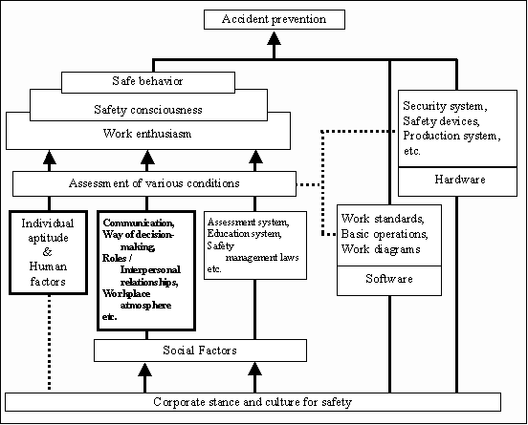
Structure of Accidents

Slide 15
Summary
Accident causation is very complex and must be understood adequately in order to improve accident prevention.
Since safety lacks a theoretical base, it cannot be regarded as being a science yet.
This fact should not discourage us, as most of the scientific disciplines—mathematics, statistics and so on—passed through a similarly tentative phase at one time or the other.
Accident causation study holds great promise for those who are interested in developing the pertinent theory.
At present, theories of accident causation are conceptual in nature and, as such, are of limited use in preventing and controlling accidents. With such a diversity of theories, it will not be difficult to understand that there does not exist one single theory that is considered right or correct and is universally accepted.
These theories are nonetheless necessary, but not sufficient, for developing a frame of reference for understanding accident occurrences.

